Slide 1
„Role of Local Networks in Anti- Corruption: Capacity development and collective action“
ELNF 2012, Belgrade Juergen Janssen, Global Compact Network Germany

Slide 2
Agenda
Anti-Corruption in Germany
Activities of DGCN
Learning
Collective Action
Cooperation within the UNGC

Slide 3
Anti-Corruption in Germany
Developments & Challenges
14th on the TI Corruption Perceptions Index (2011) 4th on the Bribe Payers Index (2011)
After the bribery scandal at Siemens, compliance measures have dramatically increased, esp. among the DAX-30 group of companies
Controversy: Bundestag has not yet ratified UNCAC German companies and DGCN openly push for ratification
Major challenges for companies: third-party due diligence & variations in country requirements and practice
Current discussion (and action) focuses on multinational corporations; fighting corruption in SMEs is often neglected
Notes:
Bribe Payers Index: The 2011 bribe payers index ranks the likelihood of companies from 28 leading economies to win business abroad by paying bribes

Slide 4
Learning: Activities of DGCN
Translation of RESIST publication into German
Tool for facilitating disclosure & reporting
Training on the 10th Principle

Slide 5
LEARNING Training on the 10th Principle of the GC
Content
National & International Legislation
Current Developments in Compliance
Components of an Anti-Corruption System; Managing Corruption Risk
Third Party Anti-Corruption Due Diligence
Controlling und Reporting
Focus on SMEs
Practical Tools will be presented
Reality-Check of UNGC Risk Guide (Beta-Version)
In cooperation with Humboldt Viadrina School of Governance &
Transparency International

Slide 6
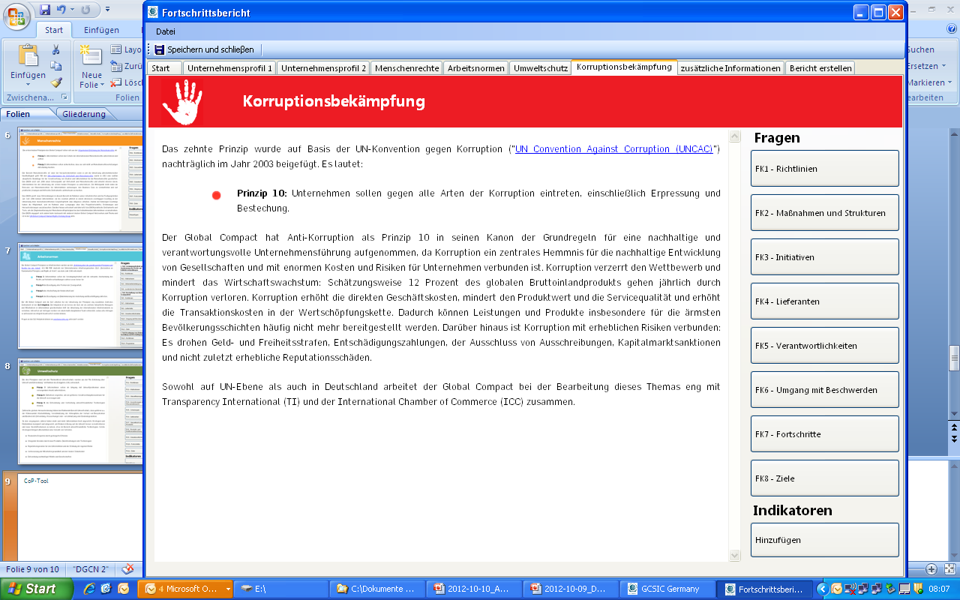
CoP-Tool

Slide 7
The Business Case for Collective Action

Slide 8
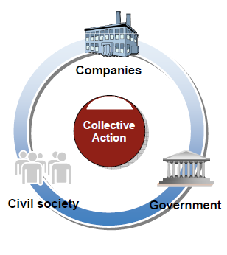
Collective Action Business Integrity Initiative (planning phase)
Aim (Working Draft)
Support of ethical business conduct through an alliance of companies, business associations, civil society and public institutions in selected countries.
Key Ideas
Utilization of existing structures to achieve the broadest possible impact
Collective action with support of the German government (BMZ)
Participation of SMEs
Capacity dvelopment, pooling of information, awareness raising
Pilot Country: India (Alternatives: Thailand, Vietnam)

Slide 9
Cooperation within UNGC
Dialogue between (European) Networks on the 10th Principle
Coordination with the Working Group on the 10th Principle
Cooperation with Local Networks, e.g. in the context of the Project „Promoting Collective Action through UN Global Compact Local Networks”

Slide 10
Thank you!
Visit www.globalcompact.de

